Slide 1

Trend in Gasoline & fuel oil price in Canada
Group Members:
Mary, Areij, Kevin, Trinath

Slide 2
Objectives
What factors affect the price of gasoline and fuel?
Is there a relationship between gasoline/fuel prices and the CPI Index?
what is the trend in the price of Gasoline and fuel in the Maritime

Slide 3
Why gasoline and other fuels prices change so often? Why do gasoline and other fuel prices fluctuate so frequently?
Factors driving the price: -
Changes in world crude oil prices
Availability of supply to meet demand
Local competition among retailers
Seasonal demand, i.e. the annual spike in demand for gasoline during the summer driving season
Inventory levels

Slide 4

Our Focus
Gas prices are affected by two factors which are:
Oil prices
Consumer command
Does the data say the same thing ?

Slide 5
Dataset
The gasoline/fuel dataset has been taken from Statistics Canada
The CPI Index dataset has been taken from Statistics Canada
all provinces and territories are included in the dataset
Period : Monthly , from January-2011 to October-2022

Slide 6
Price
Mean | 121.5499
Standard Error | 0.296466
Median | 122.8708
Mode | 124.2
Standard Deviation | 14.84702
Sample Variance | 220.4341
Kurtosis | -0.22335
Skewness | -0.1946
Range | 92.05833
Minimum | 72.46667
Maximum | 164.525
Sum | 304847.2
Count | 2508
CPI_VALUE
Mean | 129.8837
Standard Error | 0.151746
Median | 129.1
Mode | 128.8
Standard Deviation | 7.599407
Sample Variance | 57.75099
Kurtosis | -0.63109
Skewness | 0.293182
Range | 38.2
Minimum | 114
Maximum | 152.2
Sum | 325748.4
Count | 2508
Descriptive statistics

Slide 7
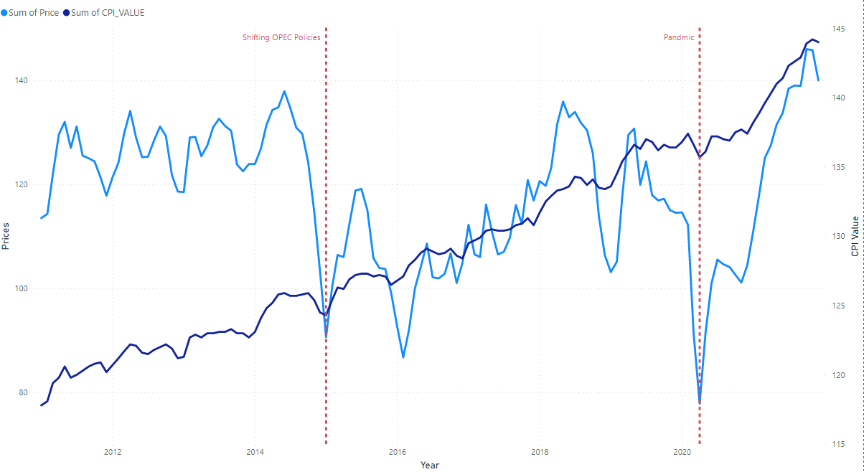
Canada

Slide 8
How about the provinces?

Slide 9
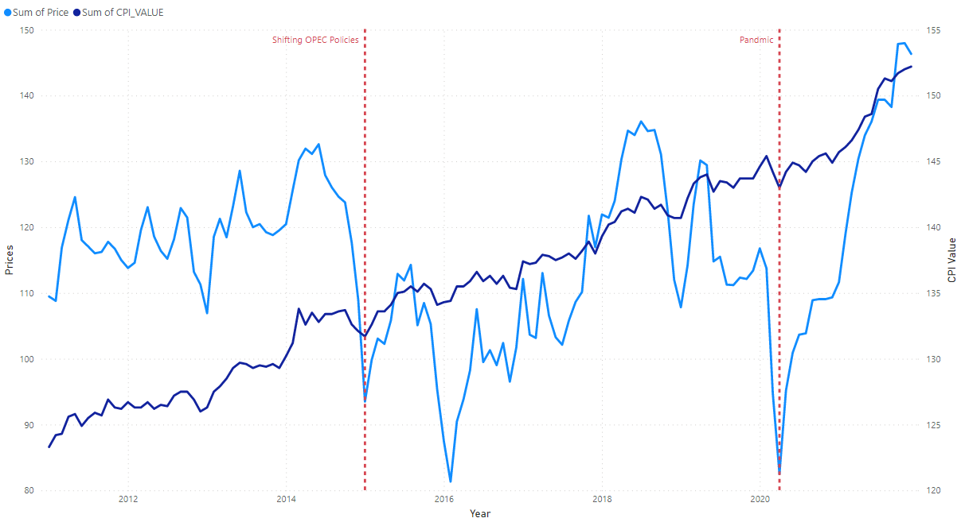
Calgary-Alberta

Slide 10
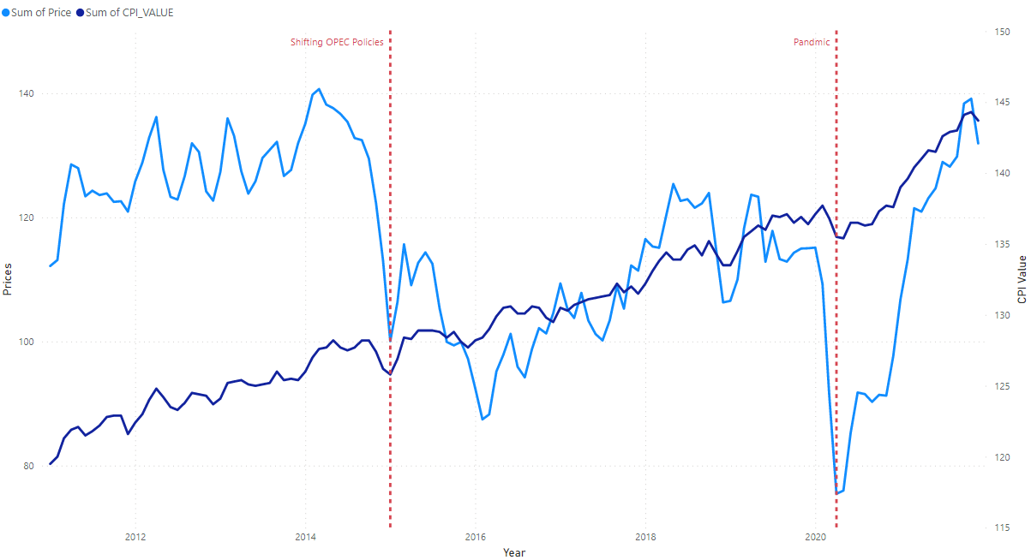
Halifax, Nova Scotia

Slide 11
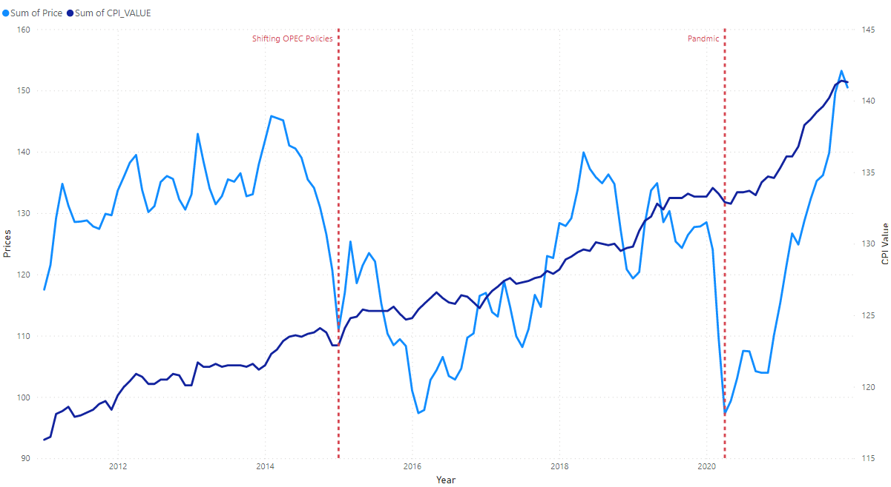
Montréal, Quebec

Slide 12
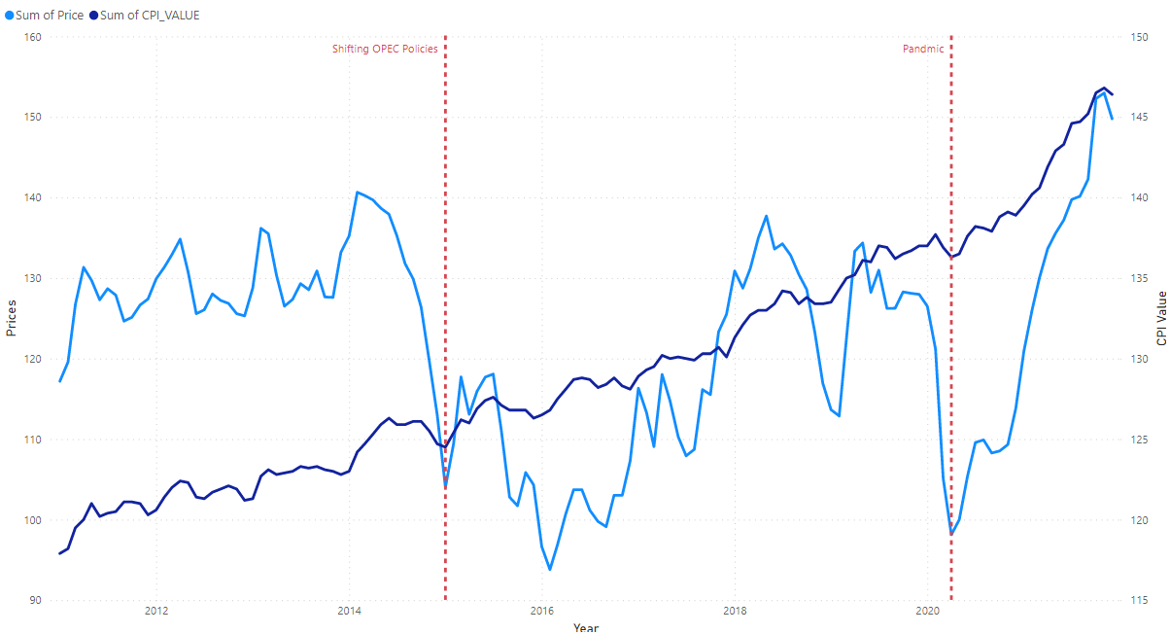
Ottawa-Gatineau

Slide 13
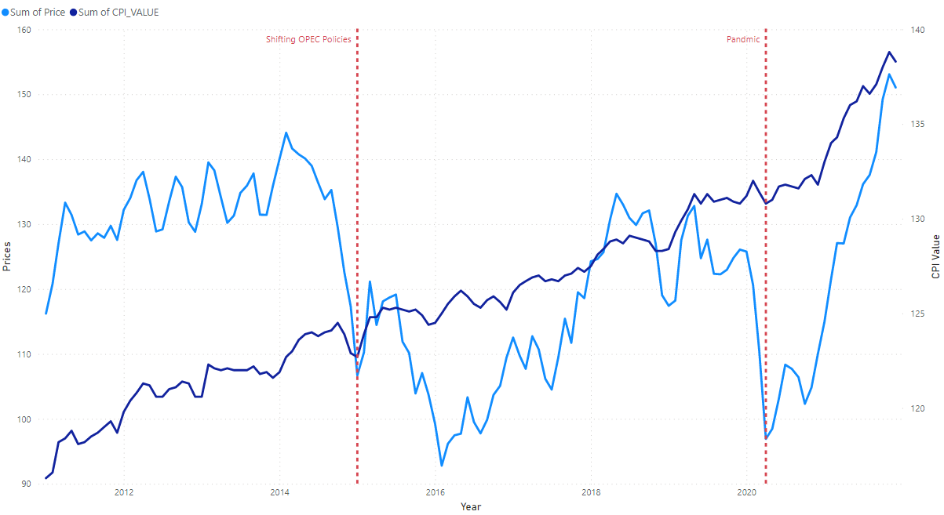
Québec, Quebec

Slide 14
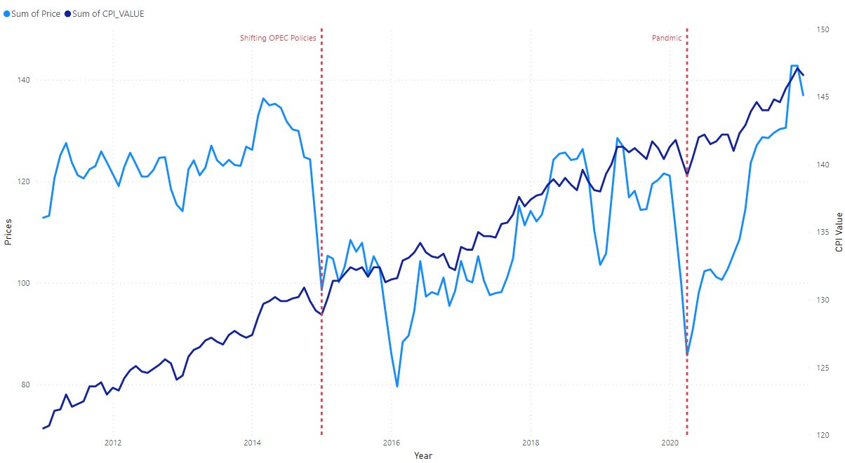
Regina, Saskatchewan

Slide 15
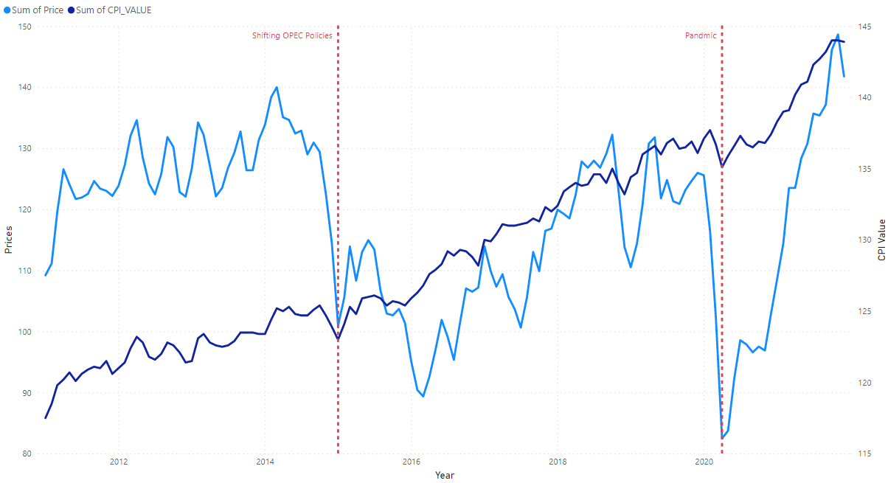
Saint John, New Brunswick

Slide 16
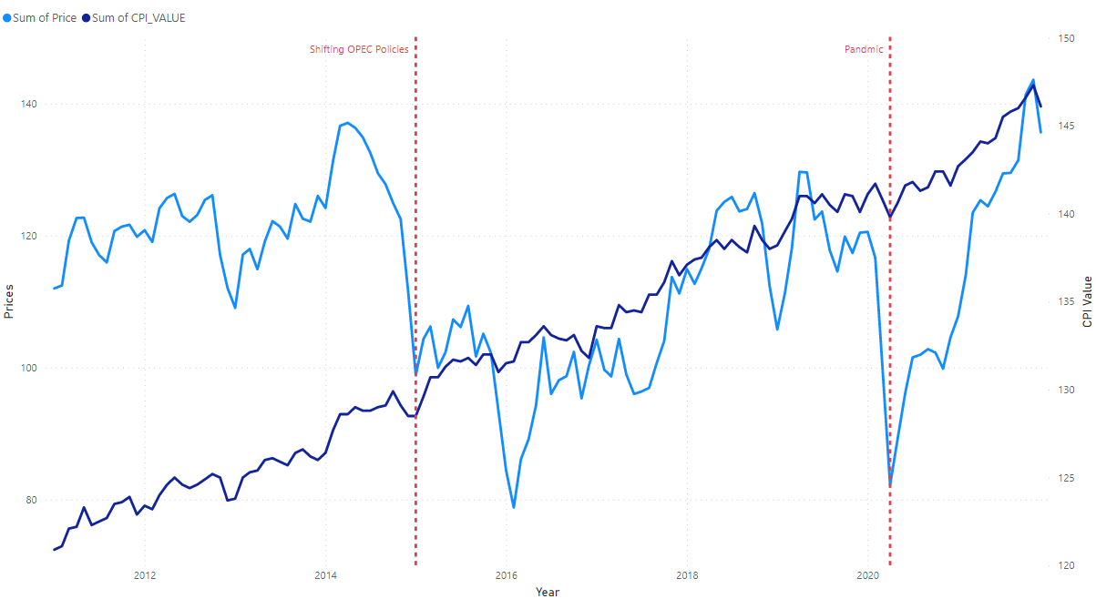
Saskatoon, Saskatchewan

Slide 17
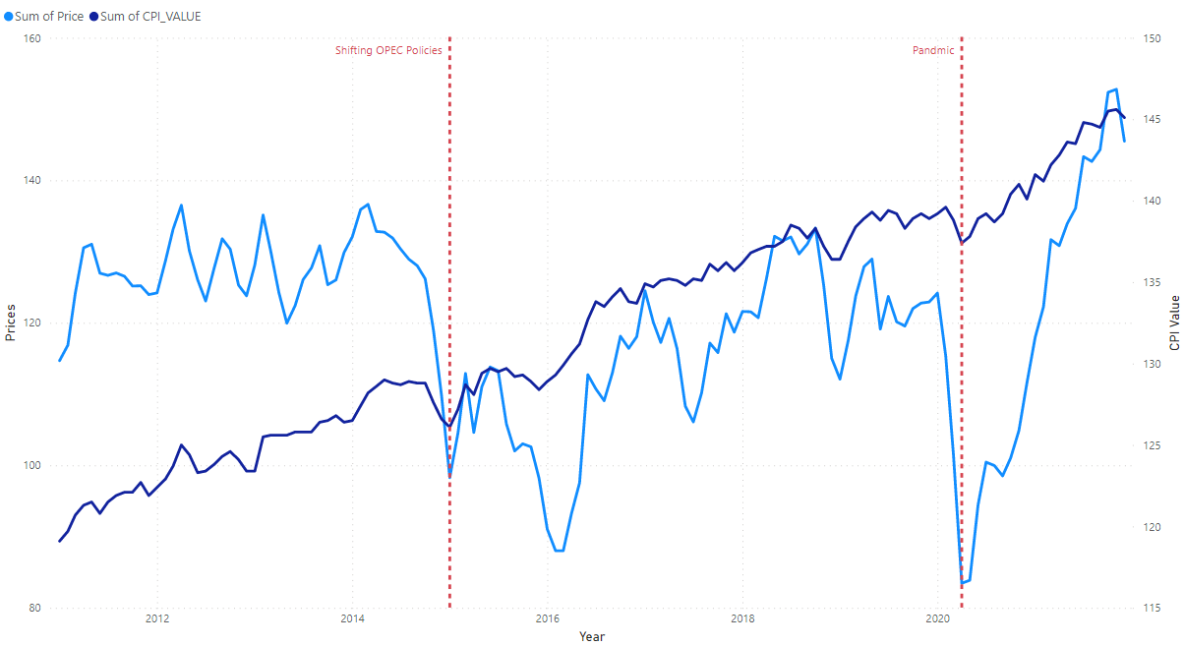
St. John's, Newfoundland and Labrador

Slide 18
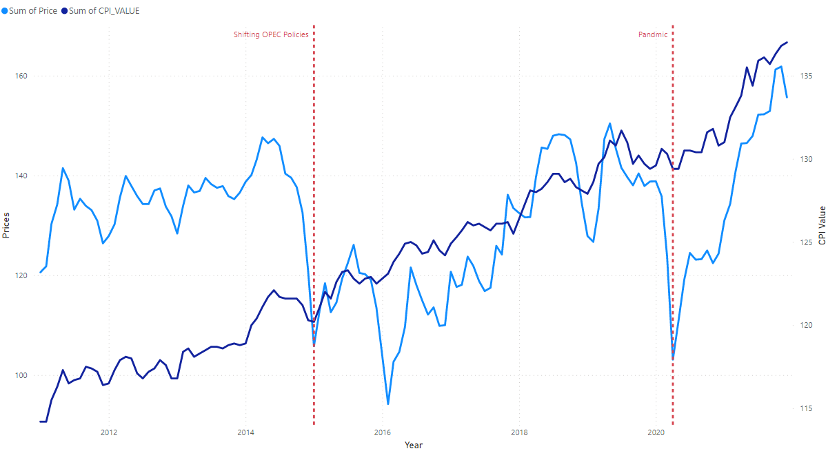
Thunder Bay, Ontario

Slide 19
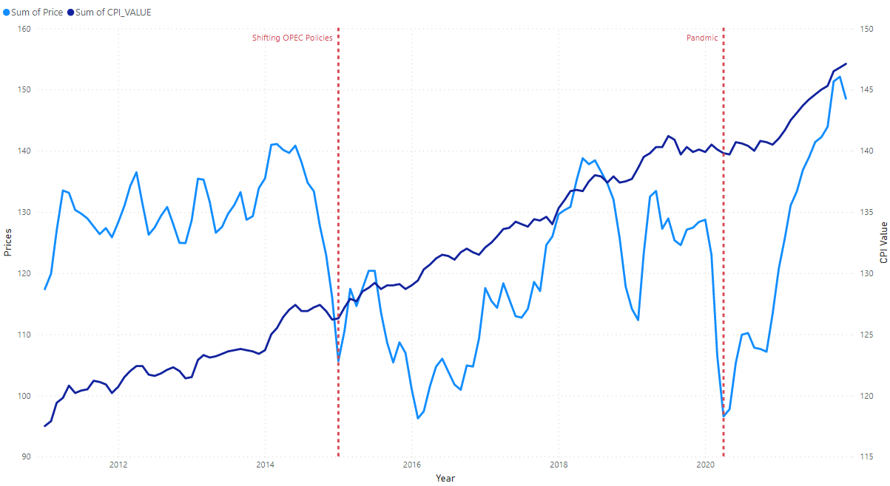
Toronto, Ontario

Slide 20
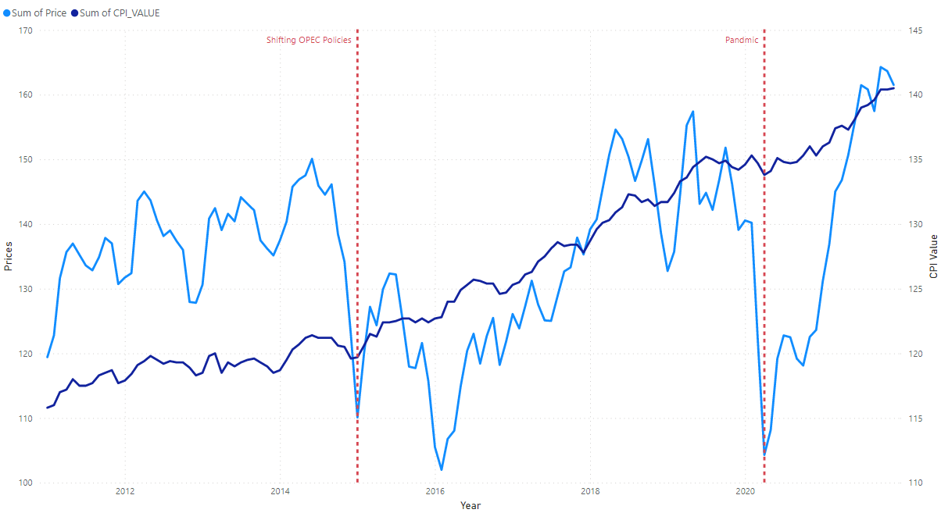
Vancouver, British Columbia

Slide 21
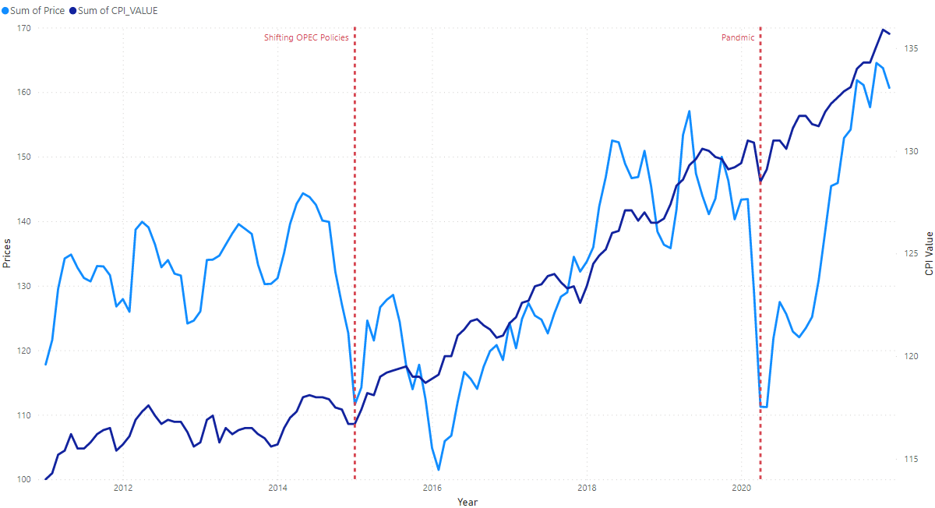
Victoria, British Columbia

Slide 22
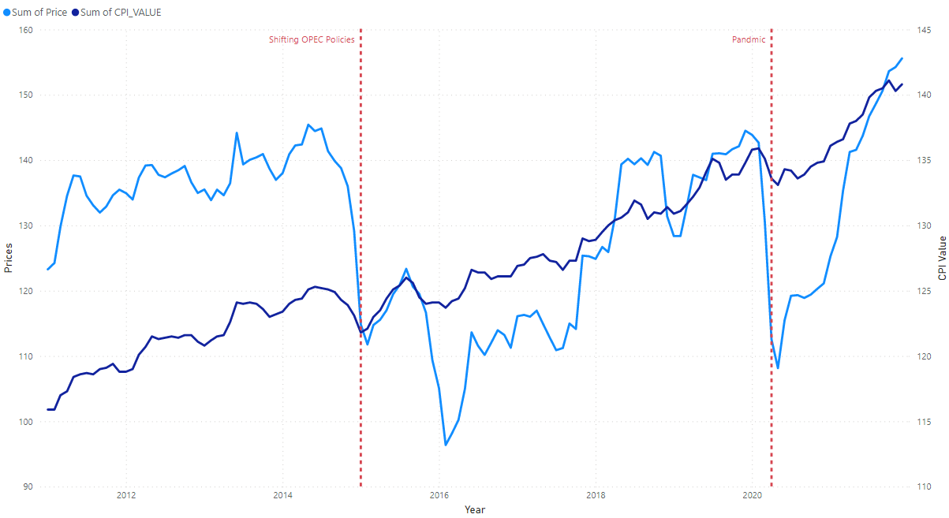
Whitehorse, Yukon

Slide 23
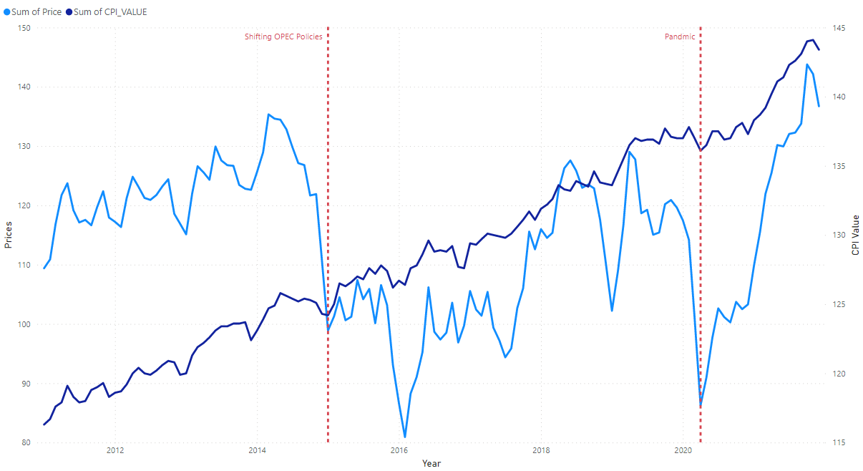
Winnipeg, Manitoba

Slide 24
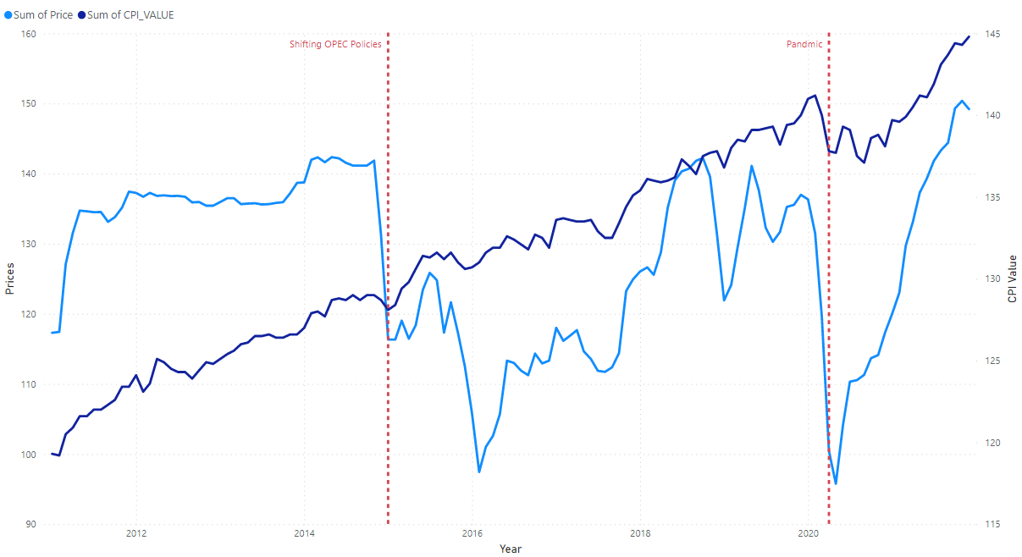
Yellowknife, Northwest Territories

Slide 25
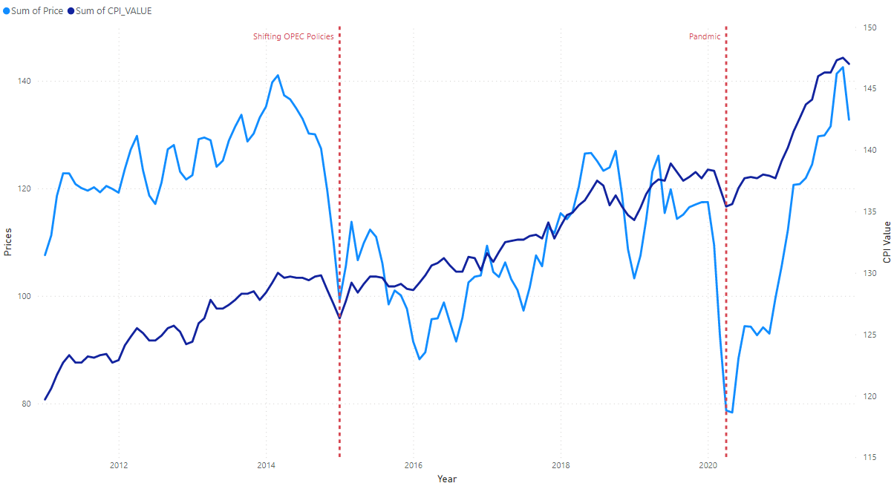
Charlottetown and Summerside, Prince Edward Island

Slide 26
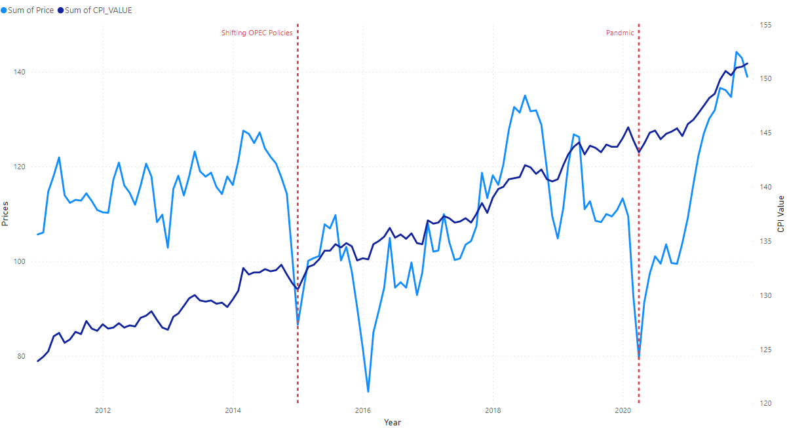
Edmonton, Alberta

Slide 27
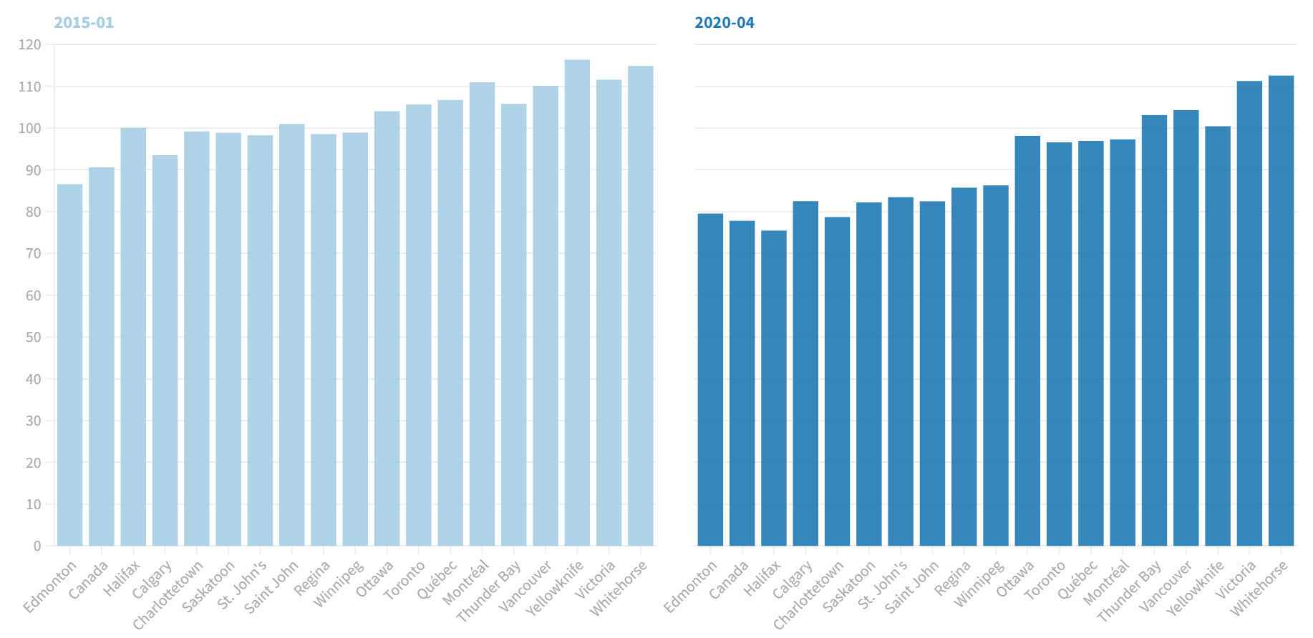
Graphical Representation of the Two Events

Slide 28
Trend in Gasoline & fuel oil price in the Maritime From Jan-2019 to Oct-2022
Flourish

Slide 29
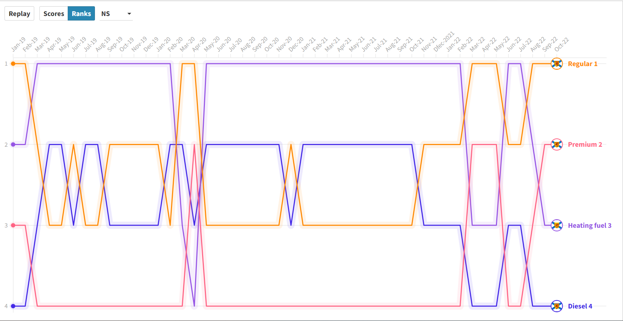
Ranking of gasoline and fuel oil prices in Nova Scotia (Jan 2019 –Oct 2022)

Slide 30
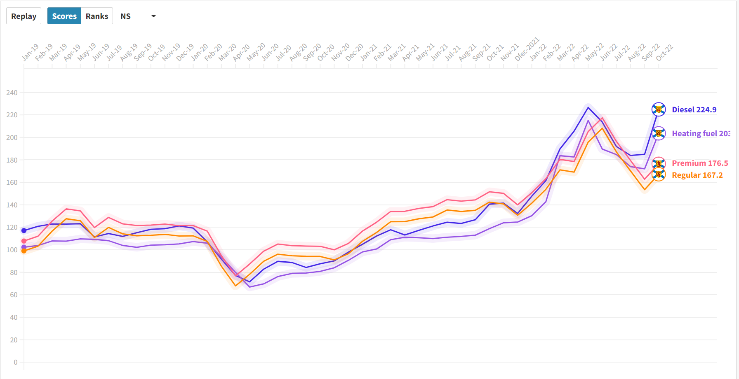
Trend in the scores of gasoline and fuel oil prices in Nova Scotia (Jan 2019 –Oct 2022)

Slide 31
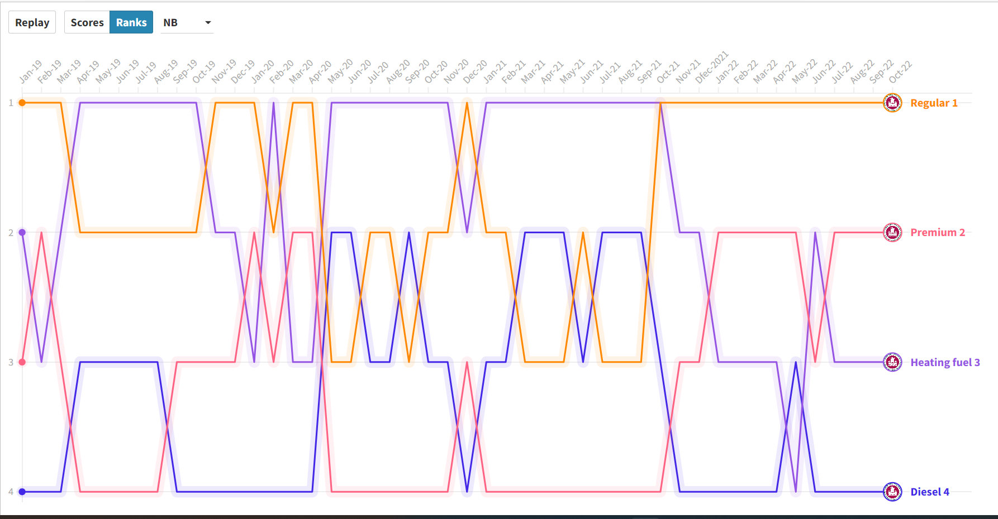
Ranking of gasoline and fuel oil prices in New Brunswick (Jan 2019 –Oct 2022)

Slide 32
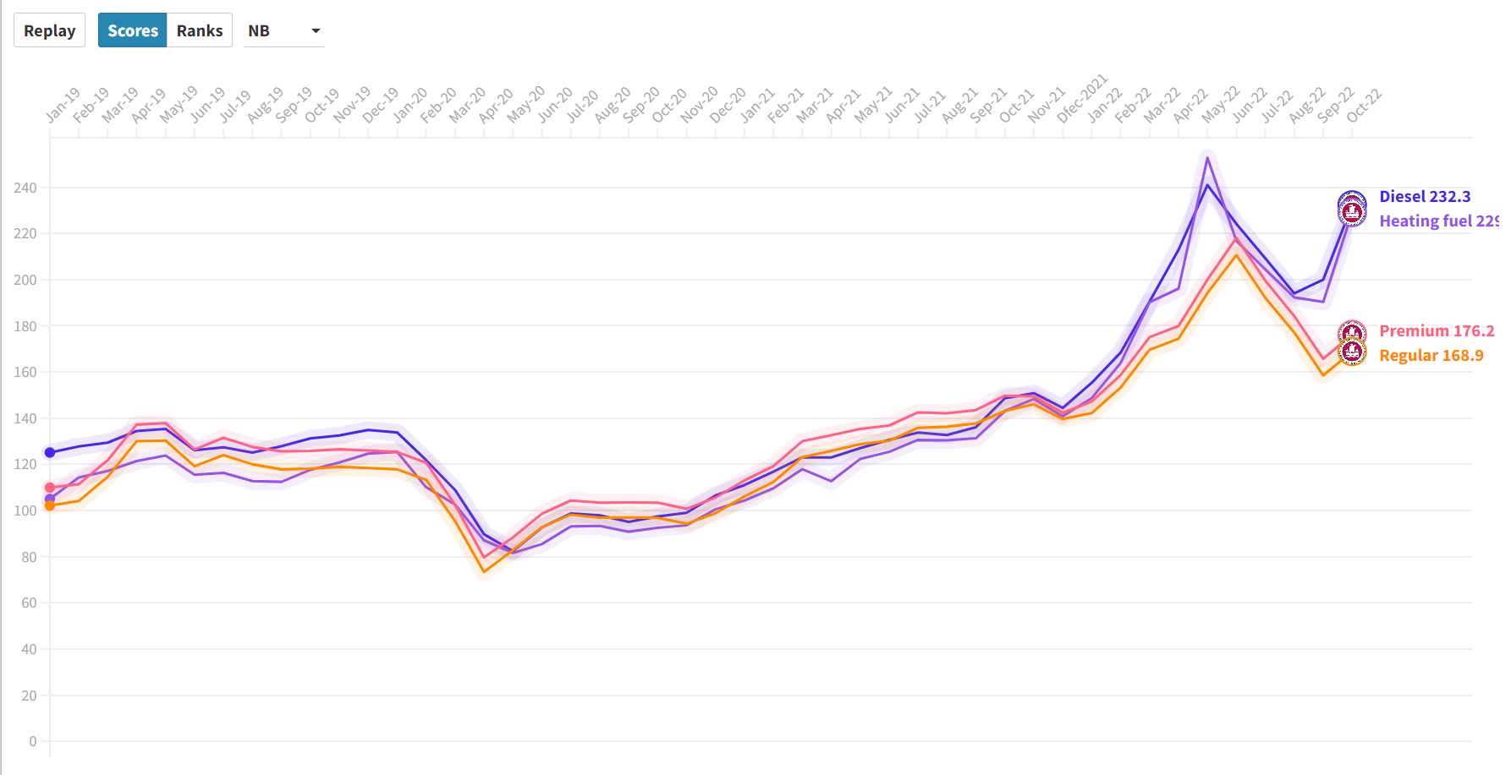
Trend in the scores of gasoline and fuel oil prices in New Brunswick (Jan 2019 –Oct 2022)

Slide 33
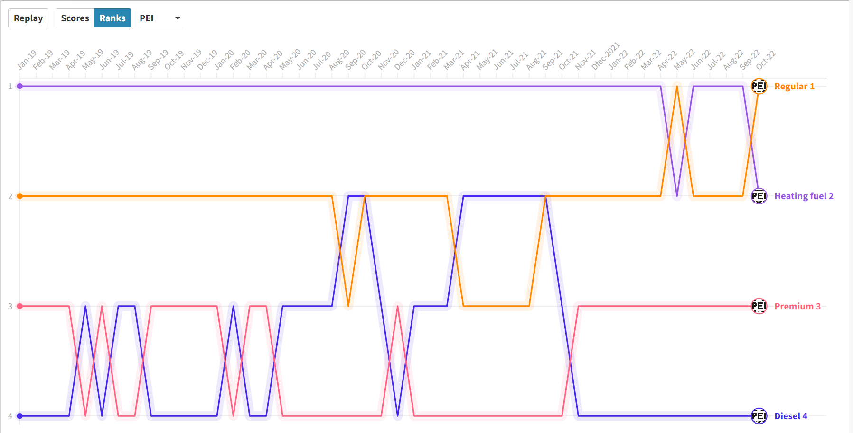
Ranking of gasoline and fuel oil prices in Prince Edward Island (Jan 2019 –Oct 2022)

Slide 34
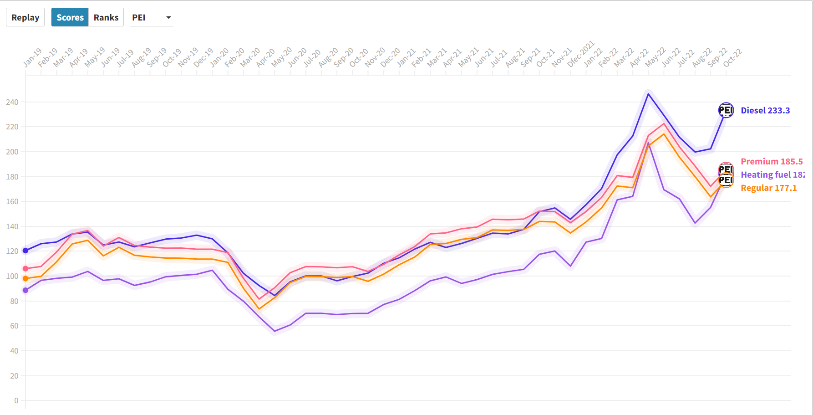
Trend in the scores of gasoline and fuel oil prices in Prince Edward Island (Jan 2019 –Oct 2022)

Slide 35
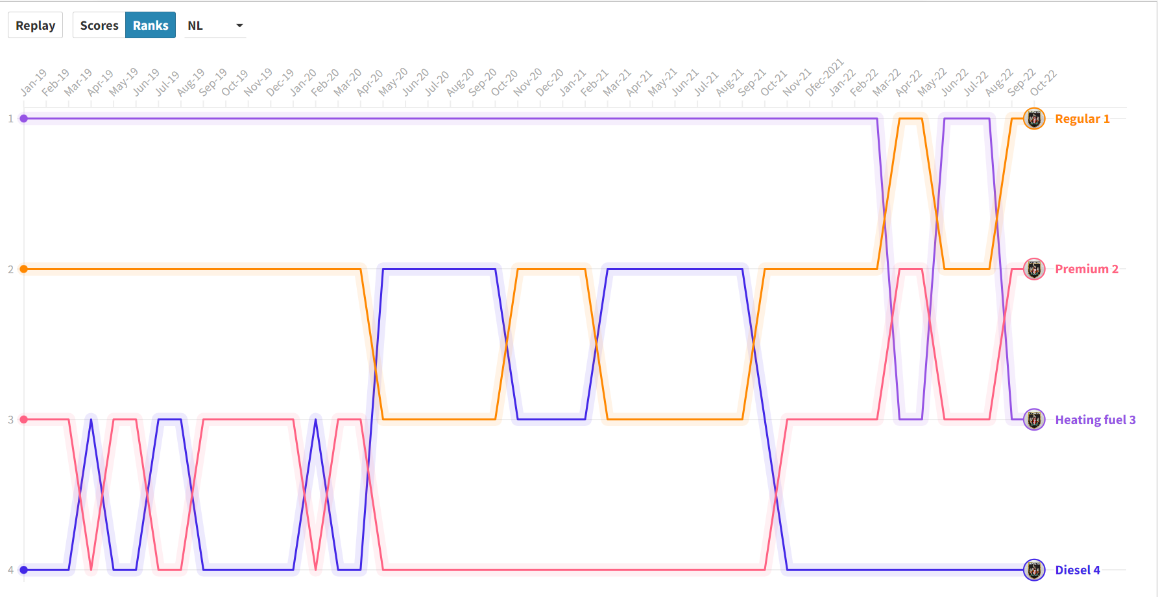
Ranking of gasoline and fuel oil prices in Newfound Land (Jan 2019 –Oct 2022)

Slide 36
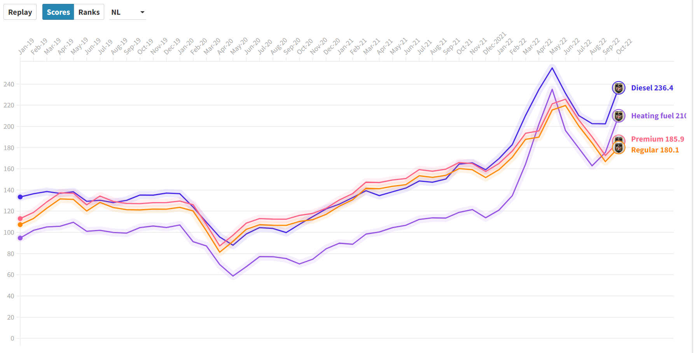
Trend in the scores of gasoline and fuel oil prices in Newfound Land (Jan 2019 –Oct 2022)

Slide 37
Conclusion
Gas and fuel prices do not have a big impact on the cpi index.
Gas and fuel prices are fluctuating through out the years
CPI index in constant increase through out the years
Oil prices and consumer command have impacted Gas and fuel prices
In April 2020 there was a dip in price all products in the Maritime during the lock down. However, as things started to open up, we see a spike in the increase in prices.
The war in Ukraine also factored the increase in 2022

